Slide 1

Algorithm Analysis IT-2101 Lecture - 9
Greedy Algorithms

Slide 2
Optimization Problem
An optimization problem is one in which you want to find, not just a solution, but the best solution
A “greedy algorithm” sometimes works well for optimization problems

Slide 3
Introduction
A greedy algorithm always makes the choice that looks best at the moment. That is, it makes a locally optimal choice in the hope that this choice will lead to a globally optimal solution.
Greedy algorithms do not always yield optimal solutions, but for many problems they do.

Slide 4
An activity-selection problem
The activity-selection problem is the problem of selecting the largest set of mutually compatible activities.

Slide 5
An activity-selection problem
Our ﬁrst example is the problem of scheduling several competing activities that require exclusive use of a common resource, with a goal of selecting a maximum-size set of mutually compatible activities.
Suppose we have a set S ={a₁,a₂,….,a_{n}} of n proposed activities that wish to use a resource, such as a lecture hall, which can serve only one activity at a time.
Each activity a_{i} has a start time s_{i} and a ﬁnish time f_{i}, where0 0 ≤ s_{i} < f_{i} < α.
Two activities ai and aj are compatible if si ≥ fj or sj ≥ fi.

Slide 6

In the activity-selection problem, we wish to select a maximum-size subset of mutually compatible activities. We assume that the activities are sorted in monotonically increasing order of ﬁnish time:
For example, consider the following set S of activities:
For this example, the subset {a₃,a₉,a₁₁} consists of mutually compatible activities. It is not a maximum subset, however, since the subset {a₁,a₄,a₈,a₁₁} is larger. In fact, {a₁,a₄,a₈,a₁₁} is a largest subset of mutually compatible activities; another largest subset is {a₂,a₄,a₉,a₁₁}.

Slide 7
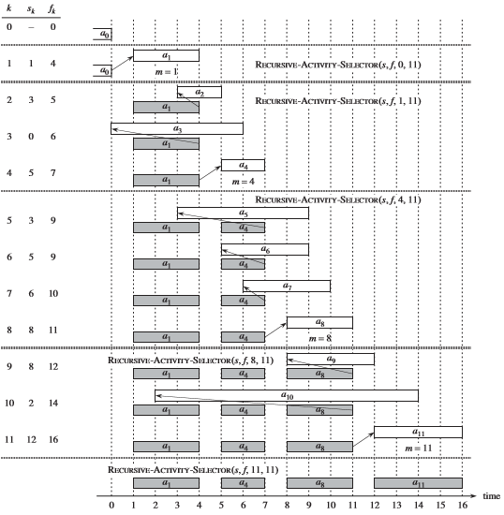

Slide 8
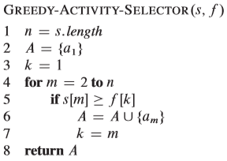
An activity-selection problem
Algorithm:
Like the recursive version, GREEDY-ACTIVITY-SELECTOR schedules a set of n activities in ‚ ϴ(n) time, assuming that the activities were already sorted initially by their ﬁnish times.

Slide 9
Elements of the greedy strategy
Greedy is a strategy that works well on optimization problems with the following characteristics:
1. Greedy-choice property: A global optimum can be arrived at by selecting a local optimum.
2. Optimal substructure: An optimal solution to the problem contains an optimal solution to subproblems.
The second property may make greedy algorithms look like dynamic programming. However, the two techniques are quite different.

Slide 10
Greedy versus dynamic programming
The 0-1 knapsack problem is the following. A thief robbing a store ﬁnds n items. The ith item is worth v_{i} dollars and weighs w_{i} pounds, where v_{i} and w_{i} are integers. The thief wants to take as valuable a load as possible, but he can carry at most W pounds in his knapsack, for some integer W . Which items should he take?
In the fractional knapsack problem, the setup is the same, but the thief can take fractions of items, rather than having to make a binary (0-1) choice for each item. You can think of an item in the 0-1 knapsack problem as being like a gold ingot and an item in the fractional knapsack problem as more like gold dust.

Slide 11
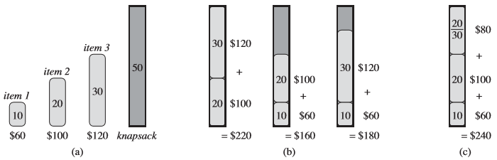
Greedy versus dynamic programming
An example showing that the greedy strategy does not work for the 0-1 knapsack problem. (a) The thief must select a subset of the three items shown whose weight must not exceed 50 pounds. (b) The optimal subset includes items 2 and 3. Any solution with item 1 is suboptimal, even though item 1 has the greatest value per pound. (c) For the fractional knapsack problem, taking the items in order of greatest value per pound yields an optimal solution

Slide 12

Huffman codes
Huffman codes compress data very effectively: savings of 20% to 90% are typical, depending on the characteristics of the data being compressed.
Suppose we have a 100,000-character data file that we wish to store compactly.

Slide 13
Huffman codes
Here, we consider the problem of designing a binary character code (or code for short) in which each character is represented by a unique binary string, which we call a codeword. If we use a fixed-length code, we need 3 bits to represent 6 characters: a = 000, b = 001, . . . , f = 101.
This method requires 300,000 bits to code the entire file. Can we do better?

Slide 14
Huffman codes
A variable-length code can do considerably better than a fixed-length code, by giving frequent characters short code words and infrequent characters long code words.
Figure shows such a code; here the 1-bit string 0 represents a, and the 4-bit string 1100 represents f. This code requires
(45. 1 + 13 .3 + 12 .3 + 16 .3 + 9 .4 + 5 .4). 1,000 =224,000 bits to represent the file, a savings of approximately 25%.

Slide 15
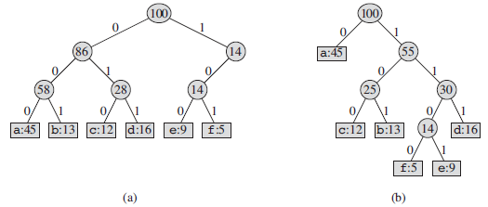
Huffman codes
(a) The tree corresponding to the fixed-length code a = 000, . . . , f = 101. (b) The tree corresponding to the optimal prefix code a = 0, b = 101, . . . , f = 1100.

Slide 16
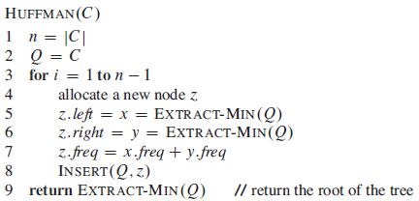
Huffman codes
we assume that C is a set of n characters and that each character c ϵ C is an object with an attribute c.freq giving its frequency.

Slide 17
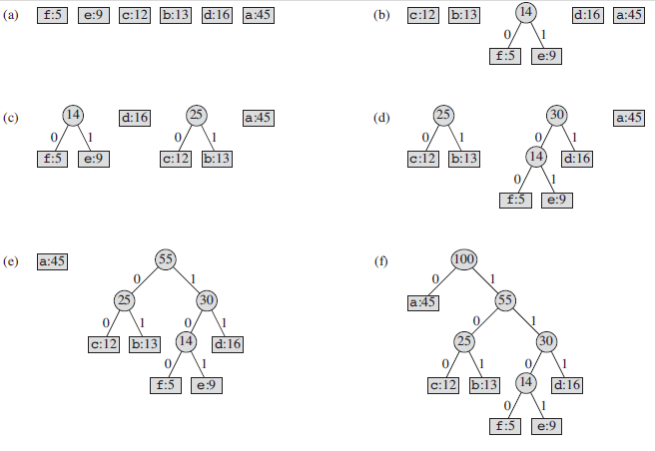
Huffman codes

Slide 18
Analysis of Huffman Code
To analyze the running time of Huffman’s algorithm, we assume that Q is implemented as a binary min-heap.
For a set C of n characters, we can initialize Q inline 2 in O(n) time using the BUILD-MIN-HEAP procedure.
The for loop in lines 3–8 executes exactly n-1 times, and since each heap operation requires time O(lgn), the loop contributes O(nlgn) to the running time.
Thus, the total running time of HUFFMAN on a set of n characters is O(nlgn).

Slide 19
Other greedy algorithms
Dijkstra’s algorithm for finding the shortest path in a graph
Always takes the shortest edge connecting a known node to an unknown node
Kruskal’s algorithm for finding a minimum-cost spanning tree
Always tries the lowest-cost remaining edge
Prim’s algorithm for finding a minimum-cost spanning tree
Always takes the lowest-cost edge between nodes in the spanning tree and nodes not yet in the spanning tree

Slide 20
Thank you

